Slide 1


Breast Cancer Survival Prediction
Madhuri Basava

Slide 2

Breast Cancer Survival Background
Breast cancer is the most common cancer among women.
In 2018, there were approximately 2.1 million new cases of breast cancer in women, accounting for 24.2% of the total cases, and the mortality rate was approximately 15.0%.
Over the past 30 years, this disease has increased while the death rate has decreased.

Slide 3
Dataset: Source
Dataset is taken from the Kaggle website: Survival Prediction Breast Cancer (kaggle.com)

Slide 4
Data Understanding
There are 334 records in the data set
There are a few missing Values

Slide 5
Dataset: Numerical Features
There are a total of 16 features out of which 5 are numerical features.
Age: Age at diagnosis (Years).
Protein1, Protein2, Protein3, Protein4: Expression levels of these proteins.

Slide 6
Dataset: Categorical Features
There are a total of 16 features out of which 9 are categorical features.
Patient_ID: unique identifier ID of a patient.
Gender: Male/Female.
Tumour_Stage: Tumor stage, classified as I, II, or III.
Histology: Histological type of the tumor, which can be Infiltrating Ductal Carcinoma, Infiltrating Lobular Carcinoma, or Mucinous Carcinoma.
ER status: Estrogen Receptor status, indicated as Positive or Negative.
PR status: Progesterone Receptor status, indicated as Positive or Negative.
HER2 status: HER2 status is indicated as Positive or Negative.
Surgery_type: Type of surgical procedure performed.
Date_of_Surgery: Date on which surgery was performed.
Date_of_Last_Visit: Date of the last visit.
Patient_Status: Status of the patient, specified as Alive or Dead.

Slide 7
Questions we want to answer
Which features are most relevant for predicting Breast Cancer survival?
Which models are suitable for Breast Cancer survival prediction?
What criteria should be used to evaluate the performance of the models?
How will the missing data be handled in the dataset?
What steps will be taken to ensure data quality and integrity?
How will data privacy be ensured, given the sensitivity of medical data?
How will the ethical implications of survival predictions be communicated to patients and healthcare providers?
How will the models be updated with new data and advancements in medical research?
How will real-time data be incorporated into the prediction models?
How will the success of the project be measured in terms of improving patient outcomes and healthcare efficiency?

Slide 8
Methodology: Data Cleaning
Checked for null values. There are some null values. Removed the records with null values.
Checked for Duplicate records. There are no duplicate records.
Removed the features that are not necessary for modeling.

Slide 9
Steps taken for Modeling
Load the data set into a data frame.
Perform the EDA to understand the characteristics of the data set.
Clean the data set. Remove the unnecessary features.
Evaluate the correlation between the variables in the dataset.
Apply various models to the data set.
Create a confusion matrix to show the performance of each model to evaluate the predicted values from the model vs. the actual values from the test dataset.
Calculate the accuracy for each model and choose the best model.

Slide 10
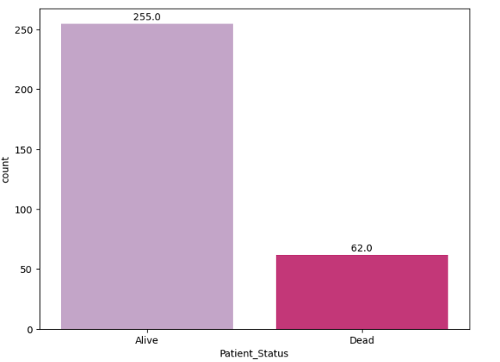
Target Distribution
From the above chart, we can see that there are 255 records with Patients Alive and 62 records with Patients Dead.

Slide 11
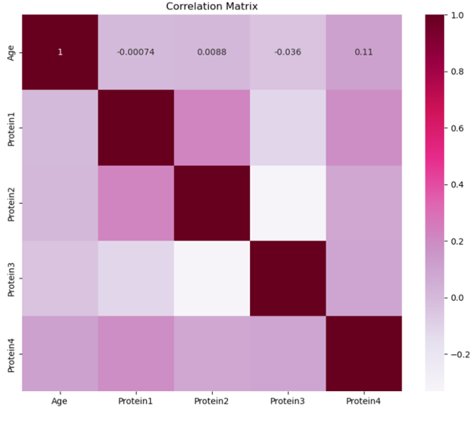
Correlation between the Numerical variables

Slide 12
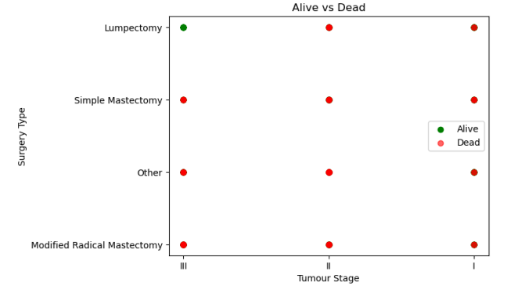
Tumour Stage vs Surgery Type
From the above graph, we can conclude that for Tumour Stage III, a Lumpectomy can be performed to help the patient.

Slide 13
Methodology: Algorithms
Random Forest Classifier
Decision Tree Classifier
XG Boost Classifier
Support Vector Machines
Logistic Regression

Slide 14
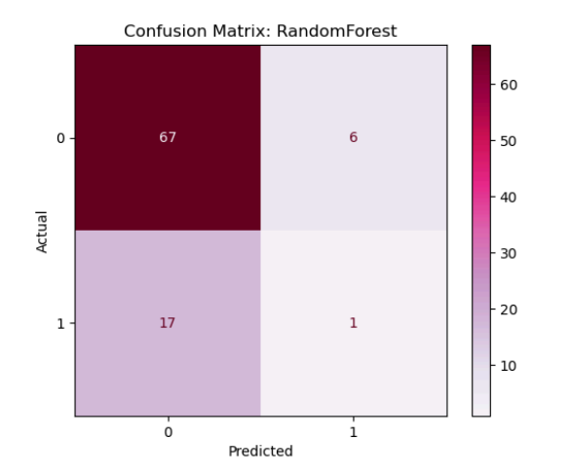
Results: Evaluation
1) Random Forest Classifier
The Accuracy obtained with the Random Forest Classifier is 0.75.

Slide 15
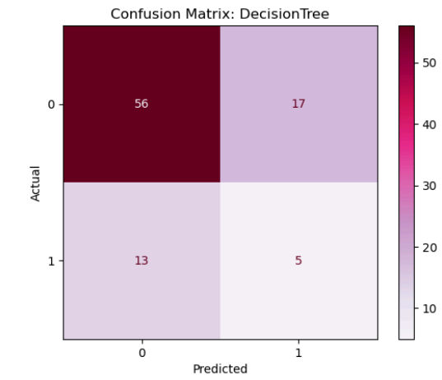
Results: Evaluation
2) Decision Tree Classifier
The Accuracy score obtained with the Decision Tree Classifier is 0.67.

Slide 16
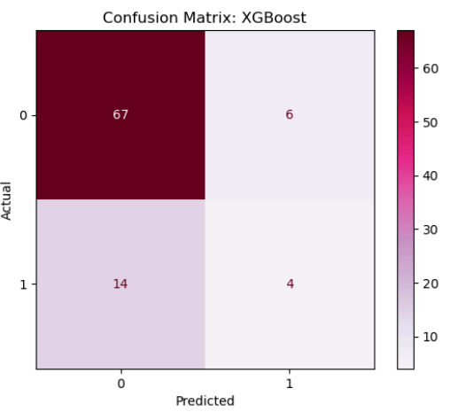
Results: Evaluation
3) XGBoost Classifier
The Accuracy score obtained with the XGBoost Classifier is 0.78.

Slide 17
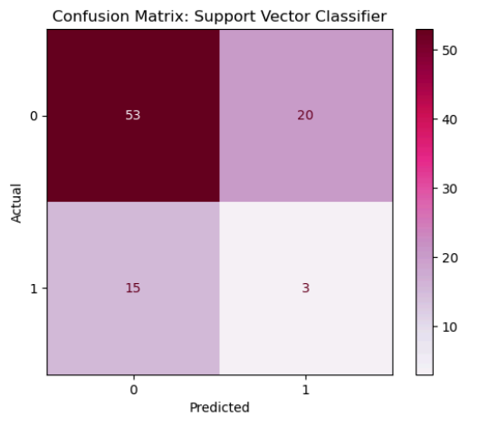
Results: Evaluation
4) Support Vector Machines
The Accuracy score obtained with the Support Vector Machines is 0.62.

Slide 18
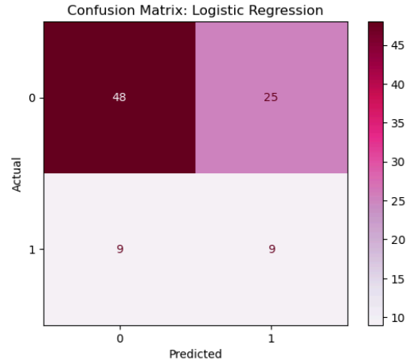
Results: Evaluation
5) Logistic Regression
The Accuracy score obtained with the Logistic Regression is 0.63.

Slide 19
Best Model Selection
The Accuracy score obtained with the Random Forest Classifier is 0.75.
The Accuracy score obtained with the Decision Tree Classifier is 0.67.
The Accuracy score obtained with the XGBoost Classifier is 0.78.
The Accuracy score obtained with the Support Vector Machines is 0.62.
The Accuracy score obtained with the Logistic regression is 0.63.
From the above scores, we can conclude that the XG Boost Classifier is the best Model.

Slide 20
Answers to the above questions
From the XGBoost classifier, ‘Tumour Stage III’, Surgery type Other, ER2 Status_Negative, Surgery_type_Mastectomy, and ‘Tumour Stage I’ features are important.
Random Forest, Decision Tree Classifier, XG Boost Classifier, Support Vector Classification, and Logistic Regression algorithms are suitable for modeling.
Metrics like accuracy, precision, recall, F1-score, and confusion Matrix are used to evaluate the performance of the models.
Missing data is handled using the imputation technique by removing the rows with null values.
Data quality will be ensured through rigorous data cleaning, validation checks, consistency checks, and by setting up a data governance framework to monitor and maintain data integrity.
The anonymization of patient data ensures data privacy. Here, in the first column, Patient_Id’s values in the data set are anonymized.
Ethical implications will be communicated through clear, understandable reports and consultations with healthcare providers, ensuring patients are fully informed about their prognosis and treatment options.
Models will be periodically retrained with new data, and a continuous learning framework will be established to incorporate the latest medical research findings.
Real-time data will be incorporated through integration with IoT platforms and wearable devices, enabling continuous monitoring and dynamic updates to predictions.
Success will be measured through metrics such as improved survival rates, patient satisfaction, reduced treatment costs, and enhanced healthcare provider efficiency.

Slide 21
Conclusion
Breast cancer survival prediction is a crucial business problem that can significantly impact patient care, healthcare economics, and medical research.
Implementing advanced predictive models can lead to better decision-making, improved patient outcomes, and more efficient resource utilization.
The above 5 models are used to predict Breast Cancer Survival and the best model (XGBoost) is chosen.

Slide 22
References
The Breast Cancer Survival Prediction dataset is retrieved from the Kaggle website:
Survival Prediction Breast Cancer (kaggle.com)
BRCA_Prediction (kaggle.com)
Prediction of Breast Cancer using Machine Learning Approaches - PMC (nih.gov)
Predicting breast cancer 5-year survival using machine learning: A systematic review - PMC (nih.gov)

Slide 23
THANK YOU
THANK YOU

